Slide 1
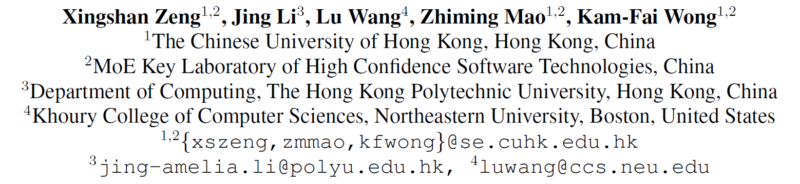
Dynamic Online Conversation Recommendation
汇报人：许琛奇
2021.4.23
ACL 2020

Slide 2
Outline
Motivation
Contribution & Related Work
Model
Experiment & Result
Discussion

Slide 3
Outline
Motivation
Contribution & Related Work
Model
Experiment & Result
Discussion

Slide 4
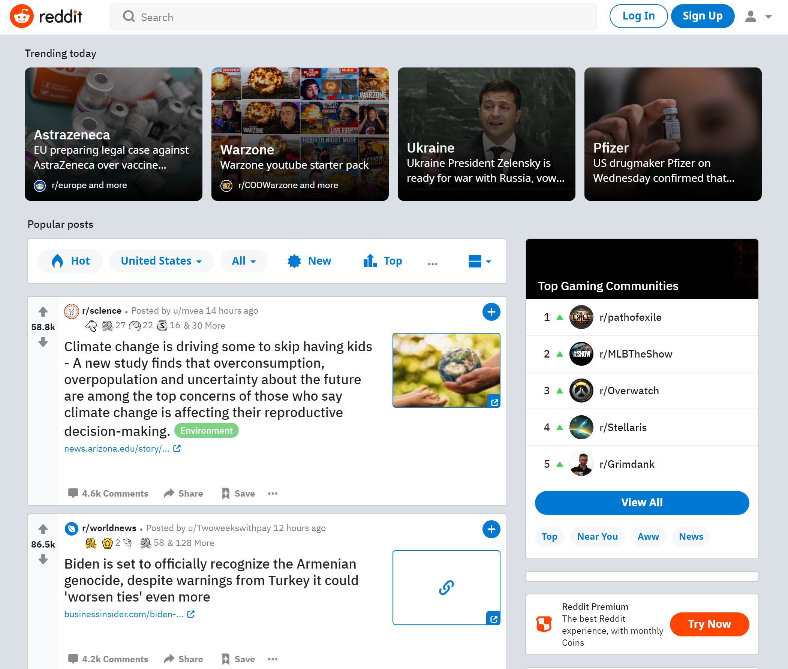
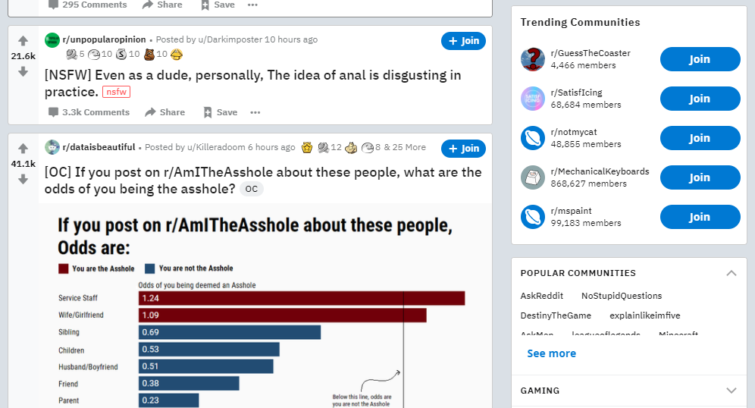
Motivation

Slide 5
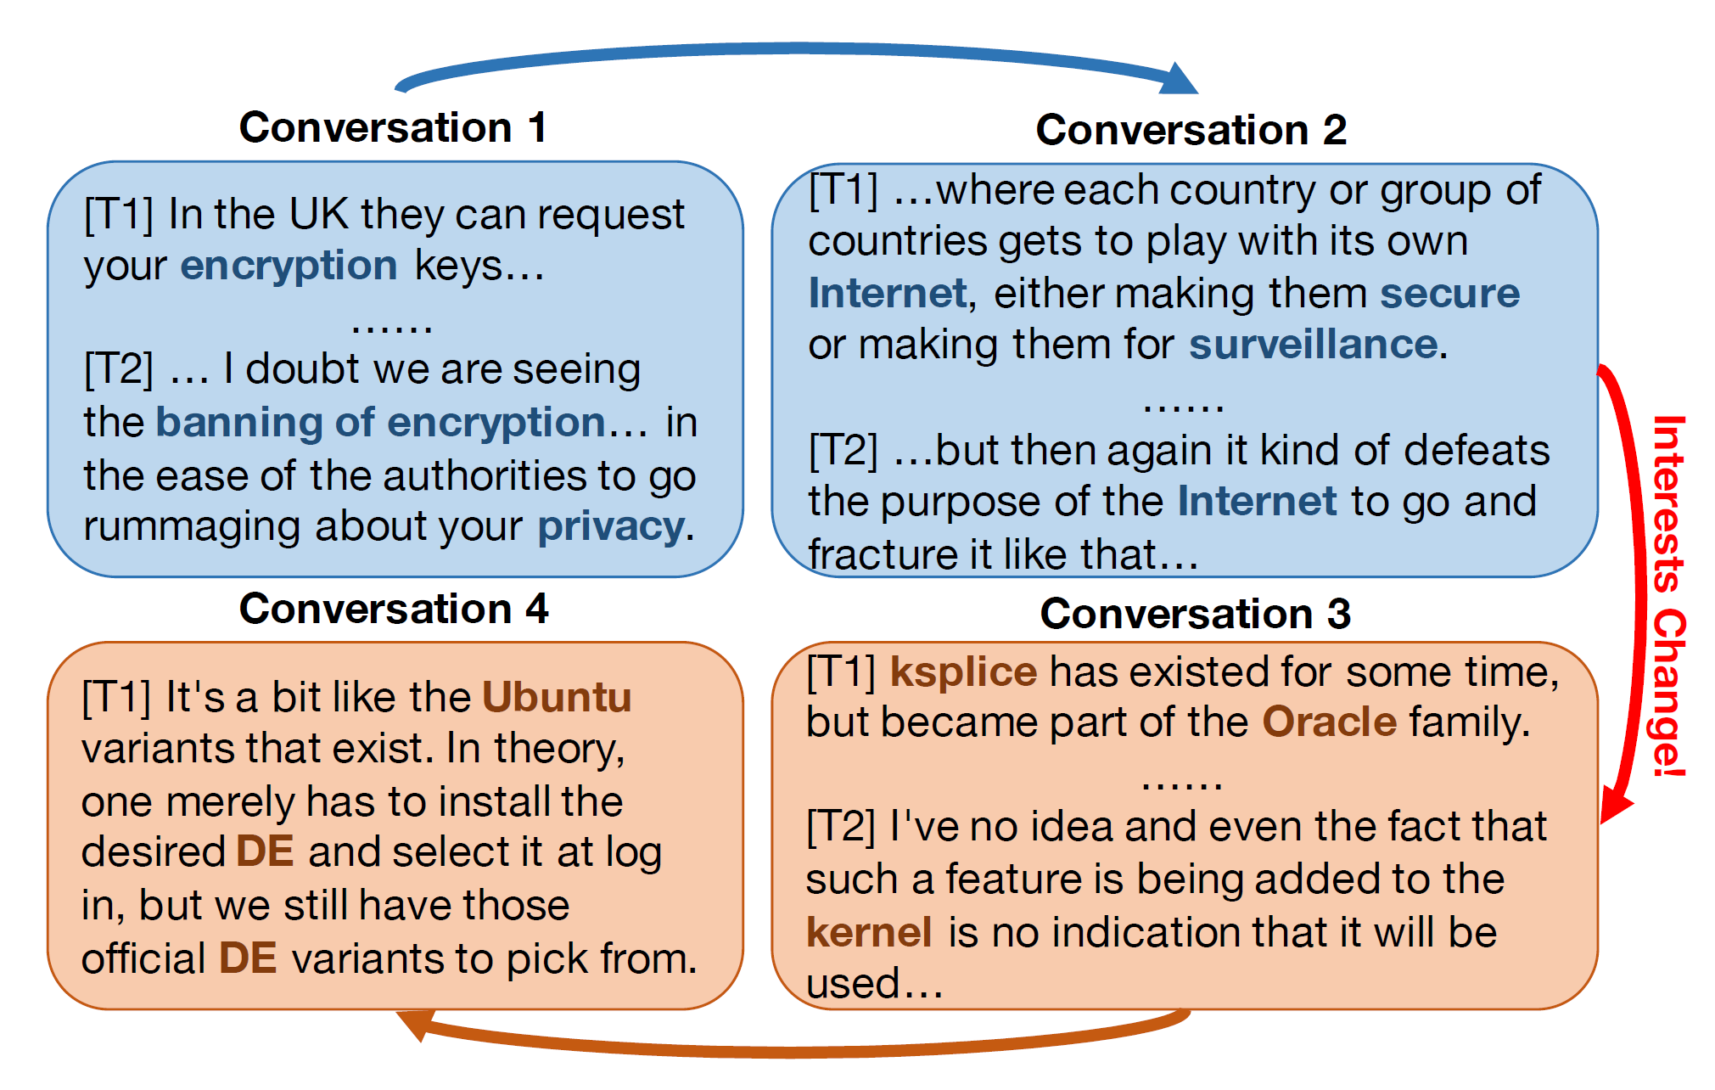
Motivation
U’s interests shifted from Internet security (conversations 1 and 2) to operation system

Slide 6
Outline
Motivation
Contribution & Related Work
Model
Experiment & Result
Discussion

Slide 7
Contribution & Related Work
Contribution
Cold start problem
Capturing changes in user interest
Data sparsity
Related Work
User Response Prediction
User interest modeling
Conversation Structure Modeling
Discovering word statistic patterns via probabilistic graphical models
Effectiveness of time dynamics

Slide 8
Outline
Motivation
Contribution & Related Work
Model
Experiment & Result
Discussion

Slide 9
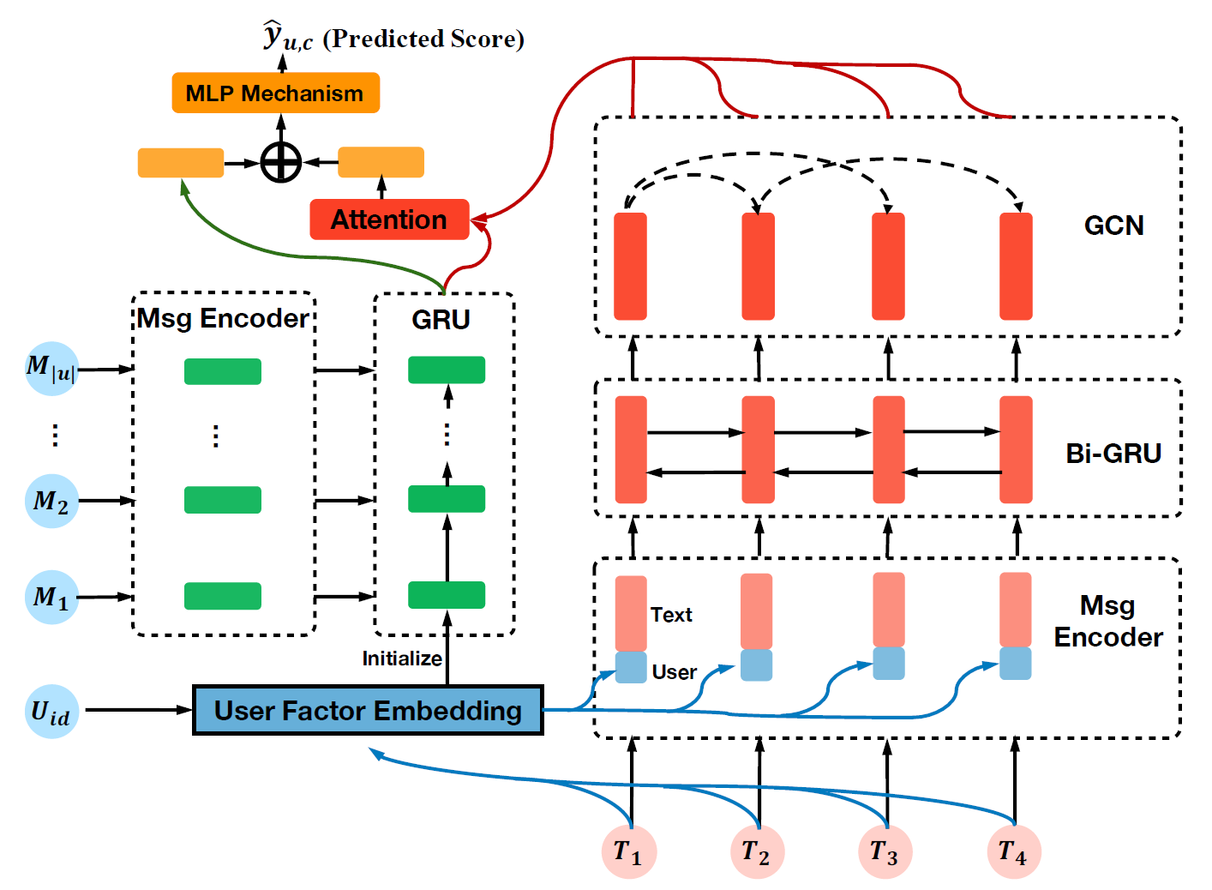
Model
Overview

Slide 10

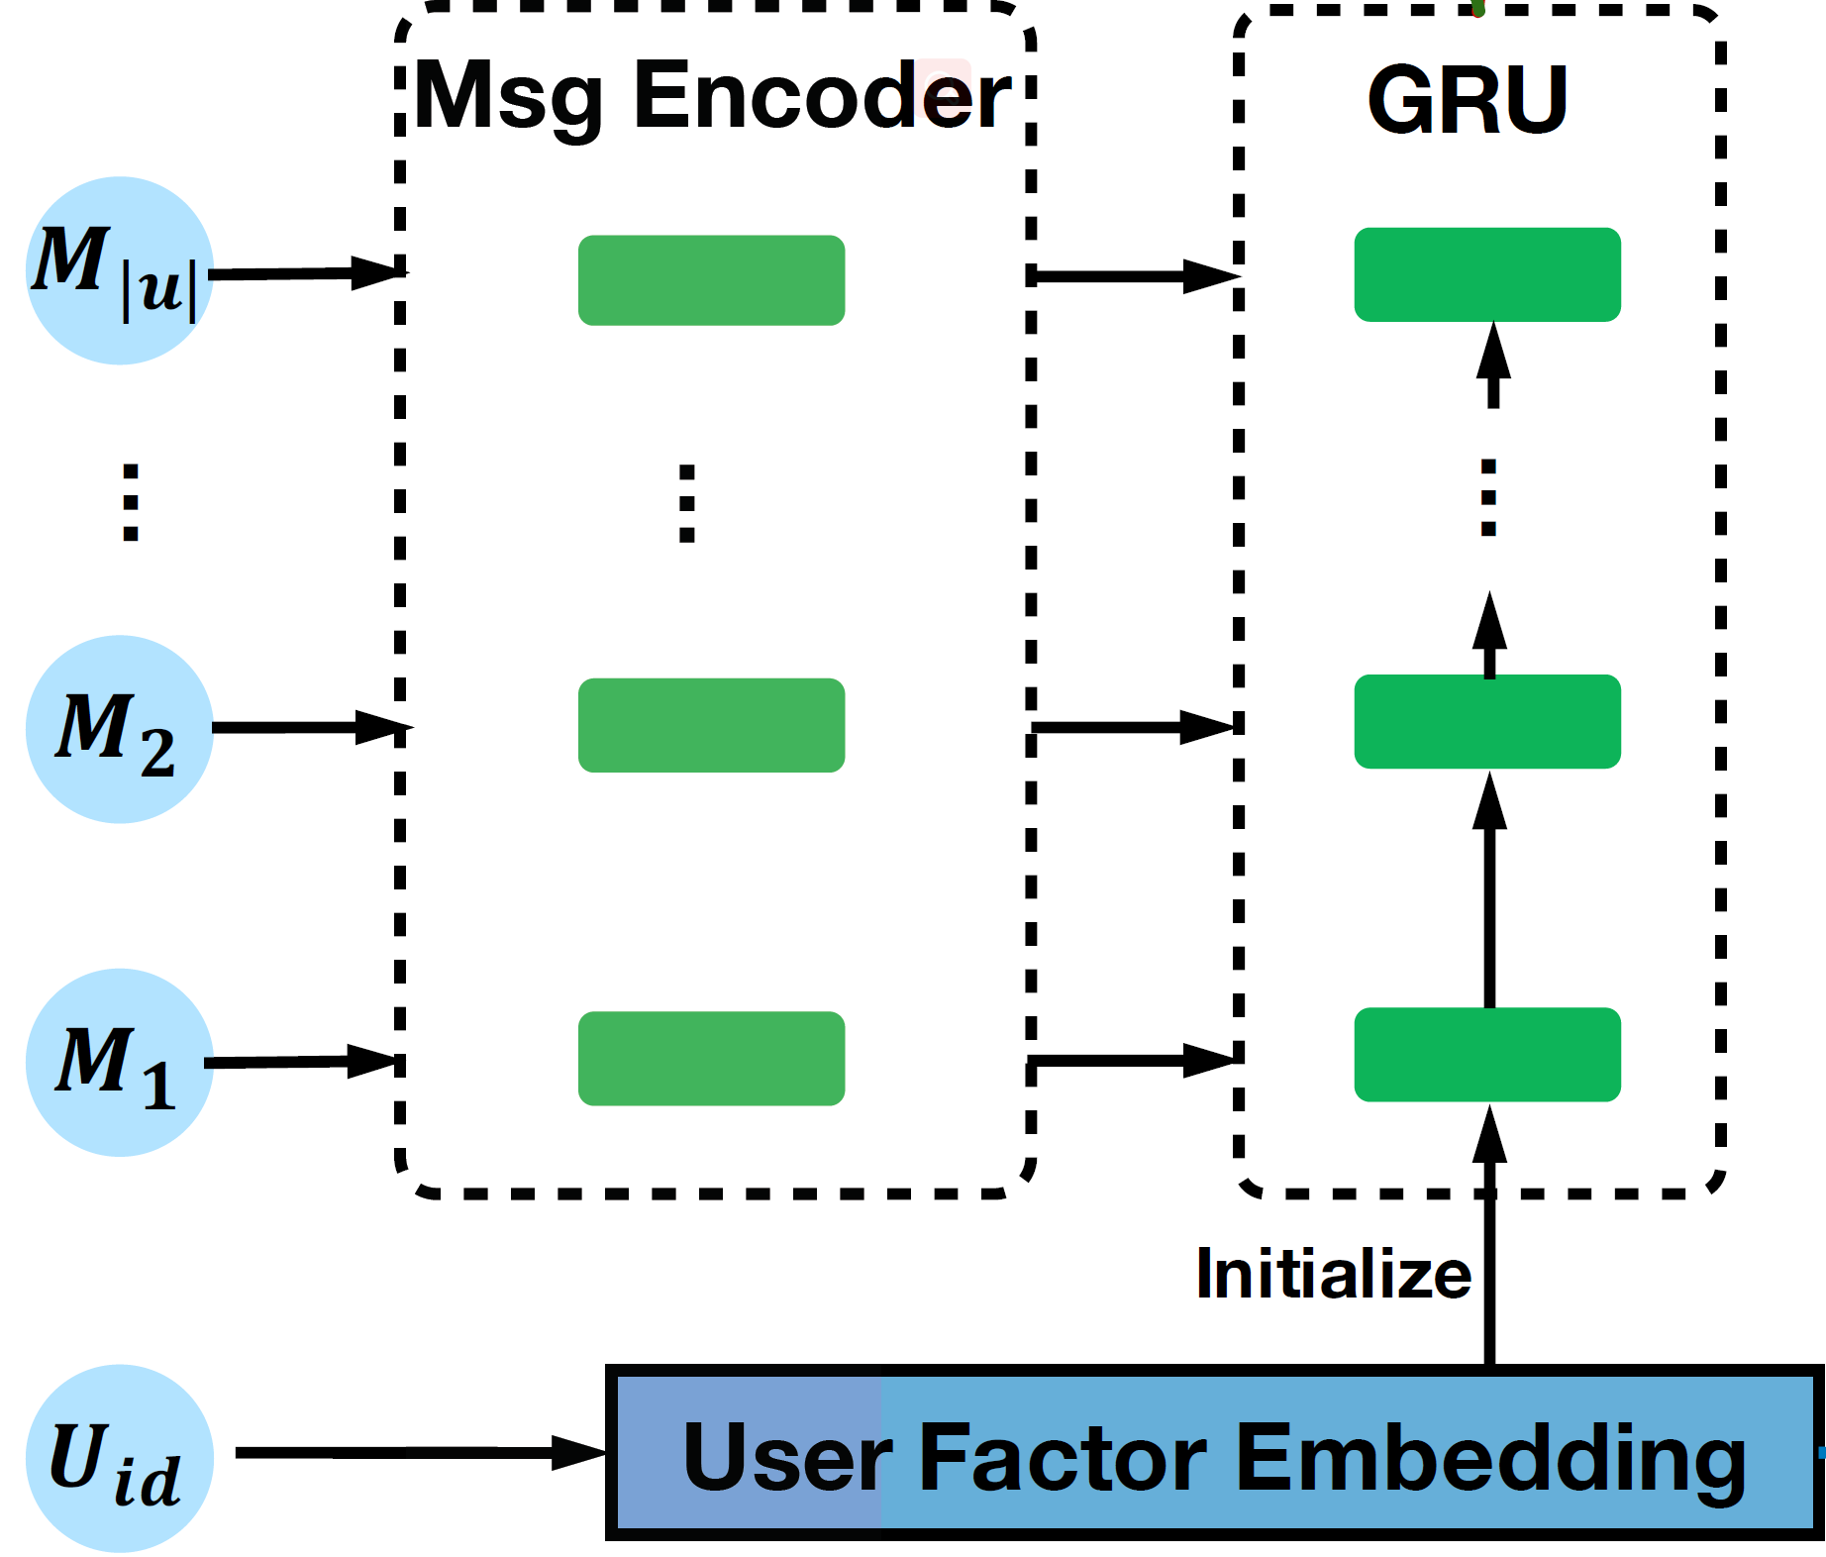



Model
User Interest Dynamic Modeling
Message-level Modeling
Glove + CNN -> z_{m}
User-level Modeling
r_{u}^{UF}

Slide 11
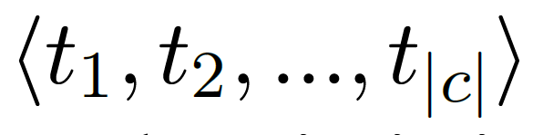
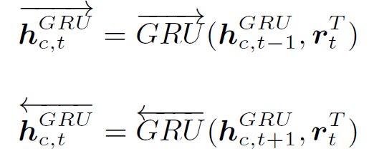
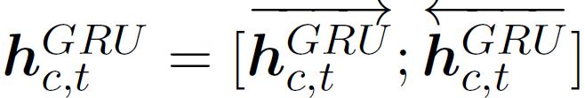
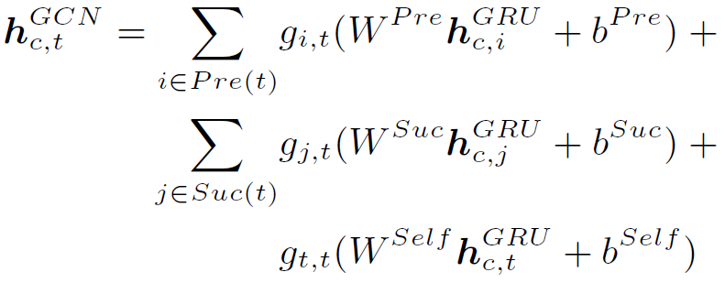
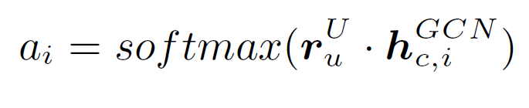
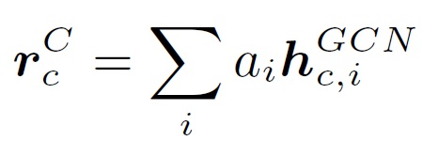
Model
Turn-level Modeling
Conversation-level Modeling
Chronological Order
Replying Structure
User-aware Attention
User-aware Conversation Modeling

Slide 12
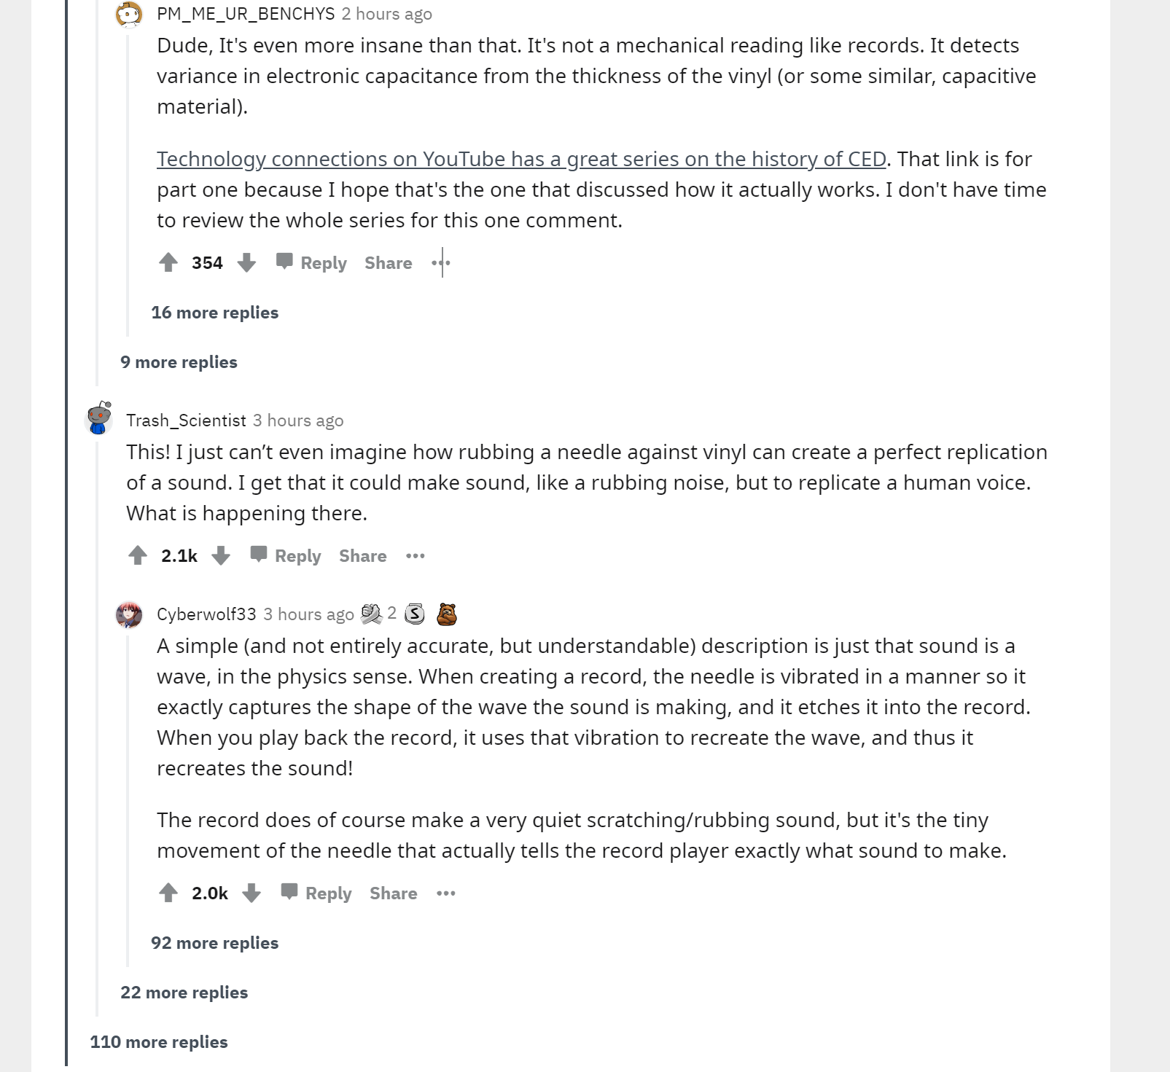
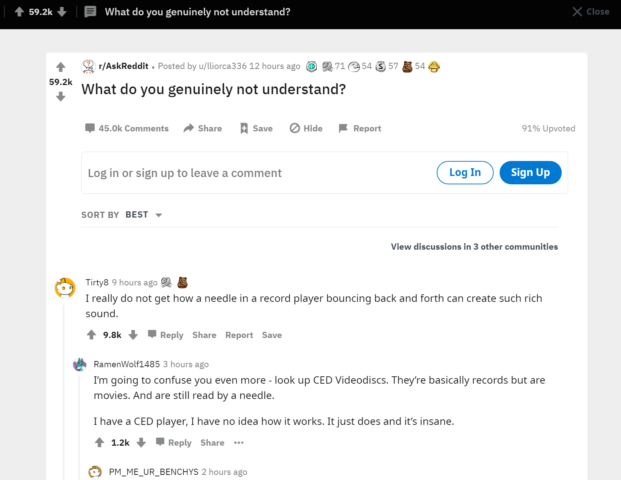
Model

Slide 13
Model
Turn-level Modeling
Conversation-level Modeling
Chronological Order
Replying Structure
User-aware Attention
User-aware Conversation Modeling

Slide 14

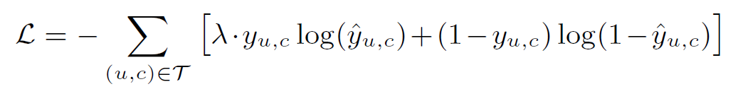
Model
Recommendation Prediction
Weighted binary cross-entropy loss:

Slide 15
Outline
Motivation
Contribution & Related Work
Model
Experiment & Result
Discussion

Slide 16
Experiment & Result
Experimental Setup
Datasets: Reddit
Technology
Today I Learned
Funny
Train: January-April 2015
Test: May 2015
https://www.reddit.com/r/datasets/comments/3bxlg7/i_have_every_publicly_available_reddit_comment/

Slide 17
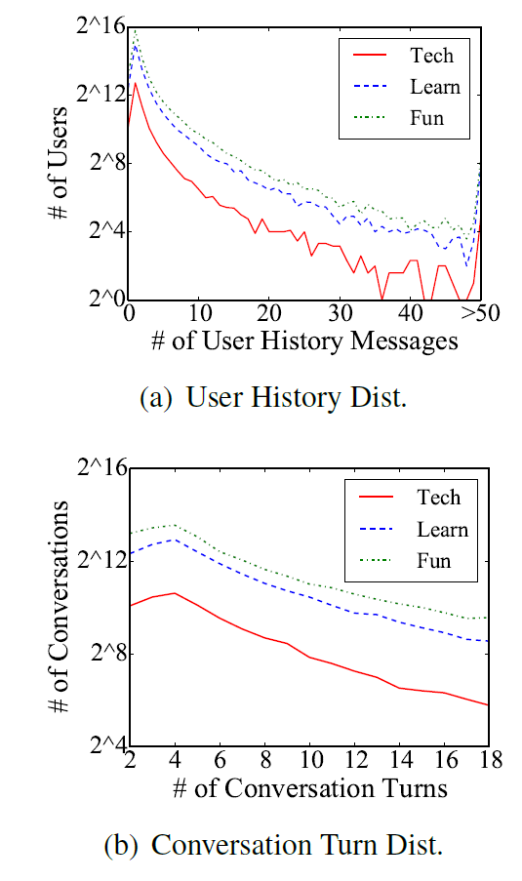
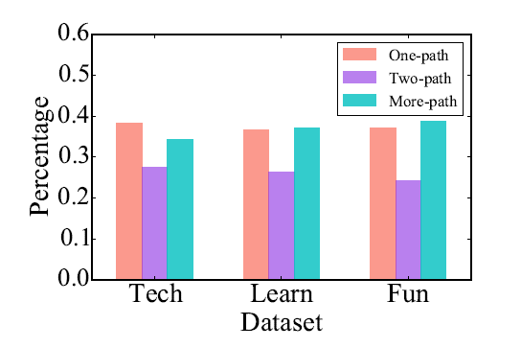
Experiment & Result
Data Analysis

Slide 18
Evaluation & Baseline
Experiment & Result
Evaluation
MAP: Mean average precision
P@1: Precison at 1
nDCG@5: Normalized Discounted Cumulative Gain at 5
Baseline
TOPICRANK
CRJTD
CRIM
LC-RNN

Slide 19
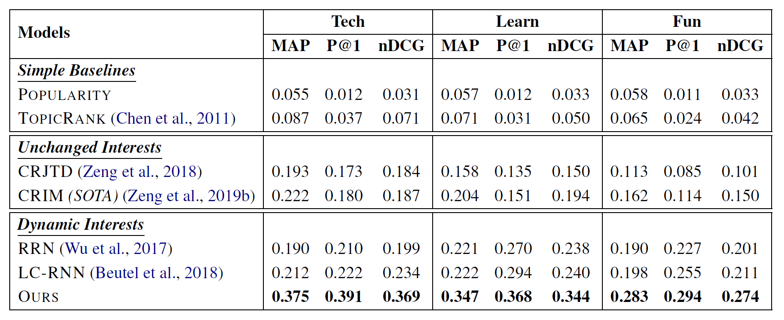
Experiment & Result
Result
https://github.com/zxshamson/dy-conv-rec

Slide 20
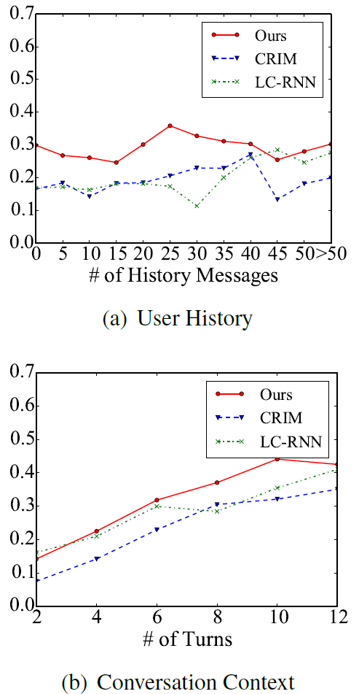
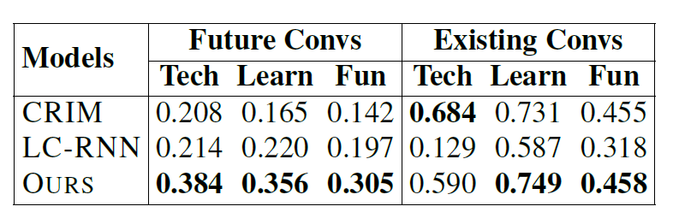
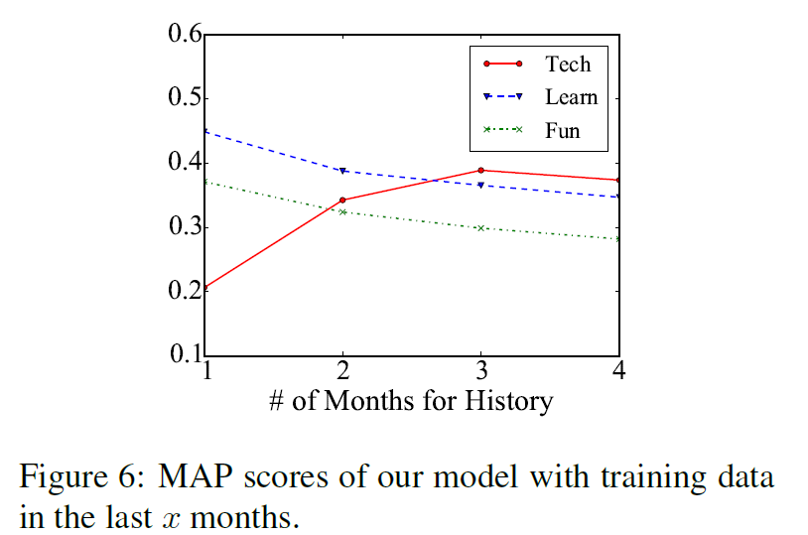
Experiment & Result
History Sparsity & Cold Start

Slide 21
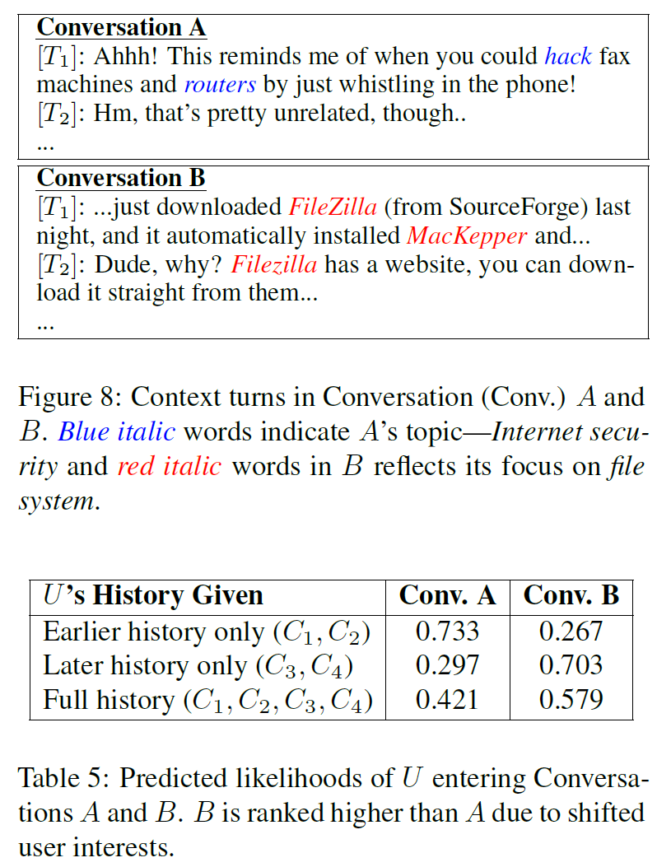
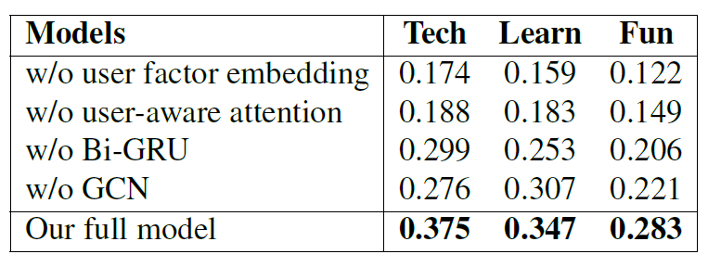
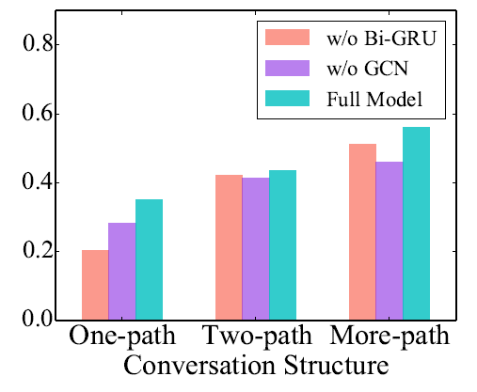
Experiment & Result
Ablation Study & Case Study

Slide 22
Outline
Motivation
Contribution & Related Work
Model
Experiment & Result
Discussion

Slide 23
Discussion
Multi-model
News Recommendation System

Slide 24
Thanks for listening！

